Slide 1

Bridging the Socioeconomic Gap in Education: A Hybrid AI and Human Annotation Approach
Nahed Abdelgaber, Labiba Jahan, Arham Vinit Doshi, Rishi Suri, Hamza Reza Pavel, Jia Zhang
CoNLL 2025 Presenter: Nahed Abdelgaber Southern Methodist University

Slide 2

Agenda
Motivation and Problem Statement
Research Objectives
Dataset Overview
Methodology
Contributions
Limitations & Future Work
Notes:
Methodology
Linguistic Analysis
Sentiment Analysis
Topic Modeling
Key Findings
Contributions
Limitations and Future Work
Q&A

Slide 3
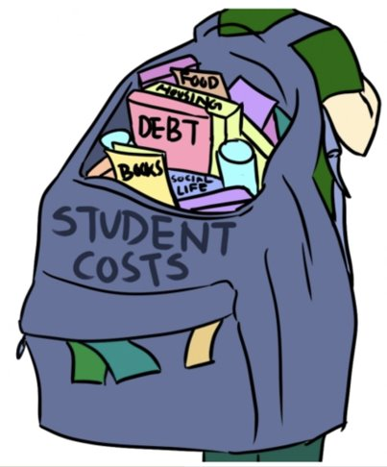
Introduction to Socioeconomic Status (SES)
What is SES? Socioeconomic Status (SES) is a measure that reflects an individual’s or group’s economic and social position relative to others, based on factors such as income, education, and occupation.
Why it matters:
Strongly linked to health, education, and access to resources
Impacts mental well-being, life outcomes, and opportunity structures
A key predictor in social science, public policy, and clinical research

Slide 4
Motivation and Problem Statement
Challenge: Socioeconomic Status (SES) is a neglected demographic in NLP.
Why Reddit?: Publicly accessible, anonymous, rich narratives.
Goal: Develop an expanded dataset of low-SES narratives to support NLP and education research.

Slide 5
Original Dataset & Filtering Criteria
Source:
Reddit dataset from (Kelbessa et al., 2024)
Selection Criteria:
Publicly available
Rich contextual content
Manually filtered for quality
Count (strict inclusion/exclusion criteria ): N = [e.g., 64 Reddit Post]
Context: Students from low socioeconomic backgrounds sharing higher education experiences
Reddit subreddits (e.g., college, AskReddit, socialwork)
Notes:
Based on 74 Reddit narratives from prior work (Kelbessa et al., 2024).
Applied strict inclusion/exclusion criteria → selected 64 valid low-SES narratives.
Criteria focused on depth, lived experience, and educational context.

Slide 6
Iterative Data Expansion Pipeline
Added to Next Iteration
Iteration Output
of Low SES
Labeled Narratives
64 Low SES Reddit Post
Classification
Clustering
Human Annotation
~799,000 Unlabeled
Reddit posts
Removed from Next Iteration

Slide 7
Iteration 1 – Zero-Shot Classification & Clustering
Phase 1: Zero-Shot Classification
Model: BART-large-MNLI
Input: ~799,000 Reddit posts
Label: “Low SES” vs “Other”
Threshold: 0.7 confidence for “Low SES”
Output: 13,635 candidate narratives
Phase 2: Clustering & Review
Embedding: SBERT
Clustering: KMeans

Slide 8
Iteration 2 – ML Ensemble Classification & Clustering
Phase 1: ML Ensemble Classification
Models: SVM and Logistic Regression
Strategy: Dual agreement with confidence > 0.7
Output: 390 high-confidence candidate narratives
Phase 2: Clustering & Review
Same SBERT + KMeans pipeline
Human validation confirms quality
Final accepted after review: 167 narratives

Slide 9
Iteration 3 – Fine-Tuned RoBERTa & Clustering
Phase 1: RoBERTa-large Classification
Fine-tuned on previously accepted low-SES samples
Applied to remaining Reddit data
Threshold: 0.7
Output: 5,195 candidate narratives
Phase 2: Clustering & Review
Clustering again with SBERT + KMeans
Annotators reviewed the clusters
Final accepted narratives:121

Slide 10
Annotation Iteration Summary
Iteration | Unlabeled Texts | Labeled (Classifier) | Labeled (Clustering) | Labeled (Human)
1 | 799032 | 13635 | 289 | 110
2 | 798743 | 390 | 381 | 167
3 | 798362 | 5195 | 444 | 121
Notes:
Narrative lengths range from 25 to 500 words
Most narratives are between 25–220 words
Few outliers above 400 words

Slide 11
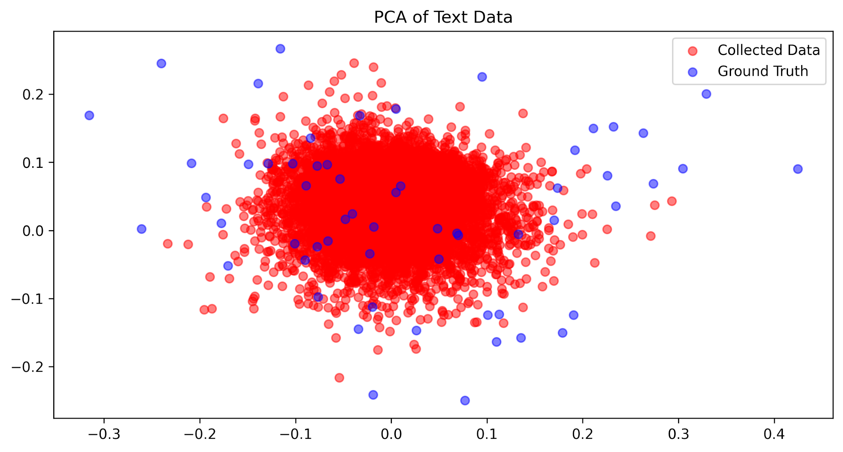
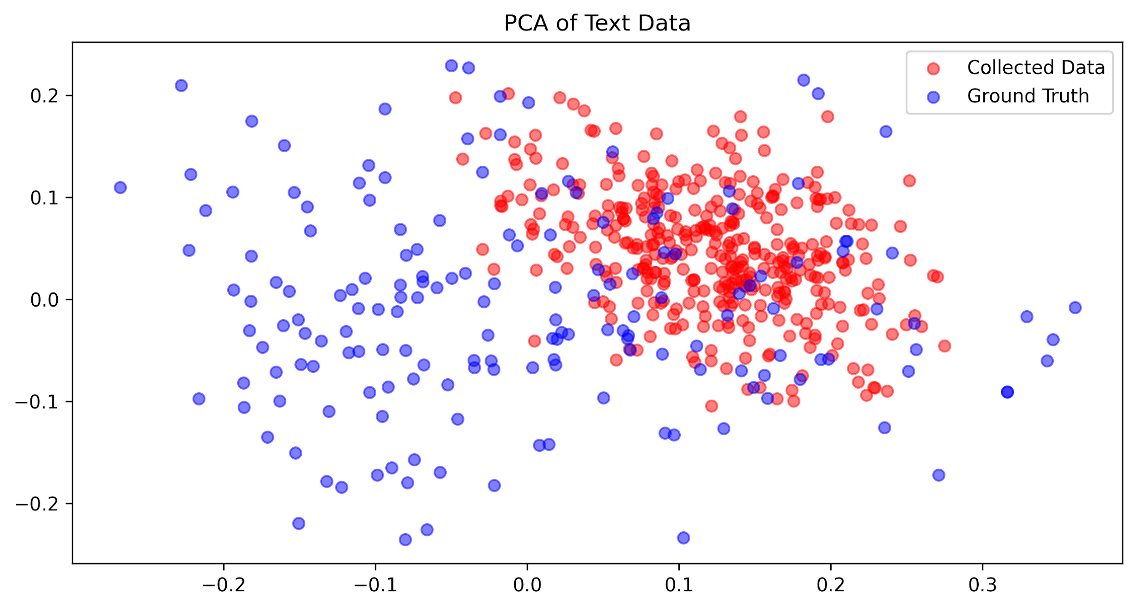
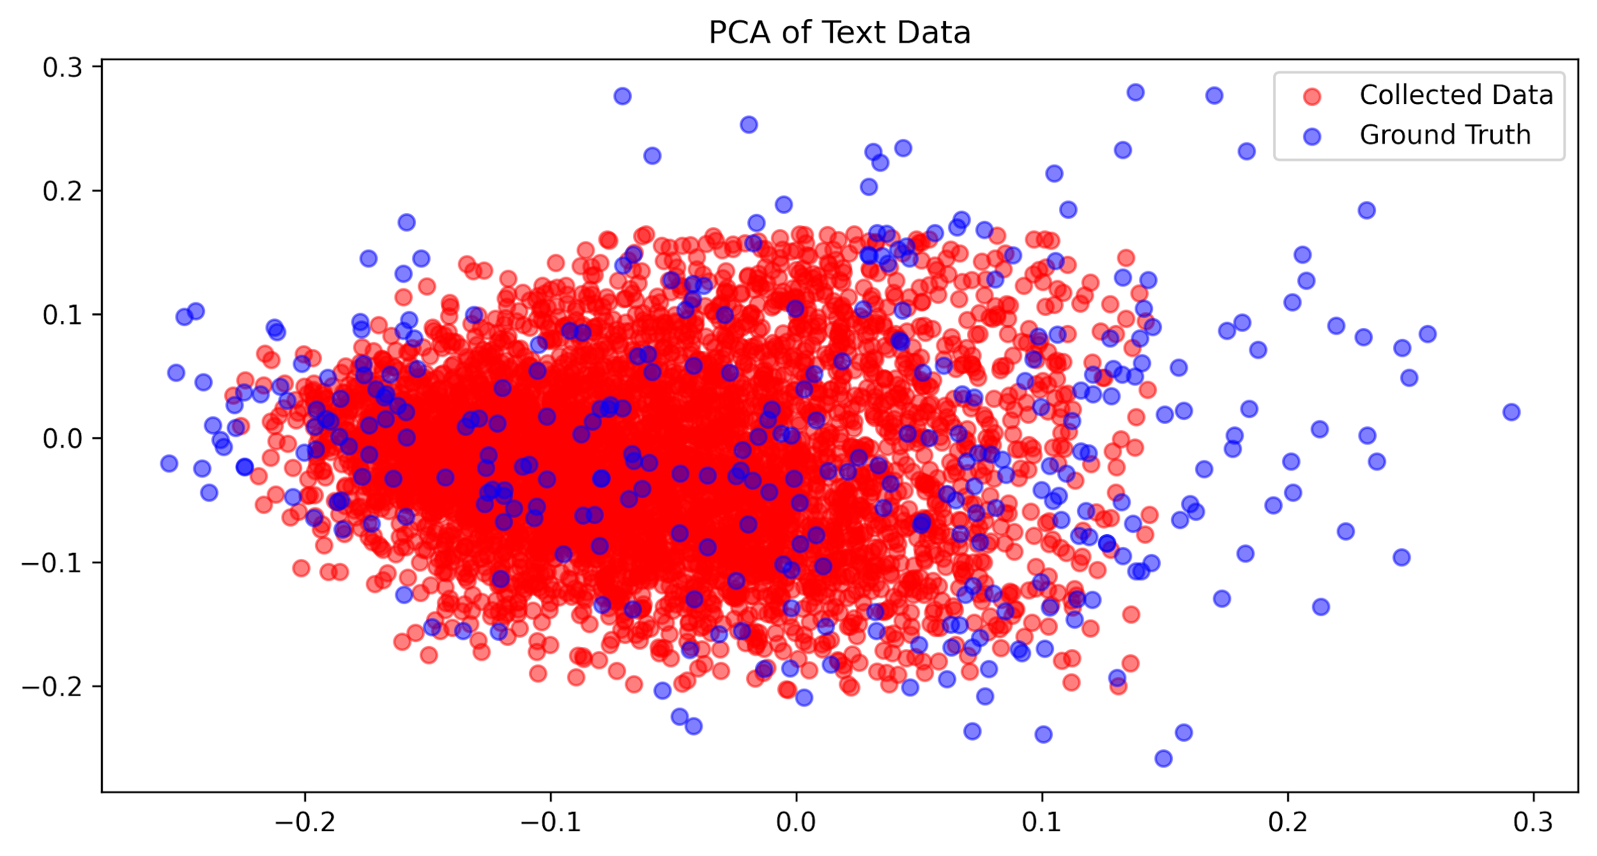
Clustering Phase Comparison per Iterations
Iteration 1 Clustering
Iteration 2 Clustering
Iteration 3 Clustering
Notes:
Narrative lengths range from 25 to 500 words
Most narratives are between 25–220 words
Few outliers above 400 words

Slide 12
Information Extraction Phase for Collected Data
Utilized a pre-trained LLaMA model (7B parameters)
Extracted structured information from student narratives
Focused on:
Backgrounds
Struggles (e.g., financial, psychological, physical, social)
Solutions shared in the narratives
Aimed to enrich the semantic profile of each narrative for deeper analysis

Slide 13
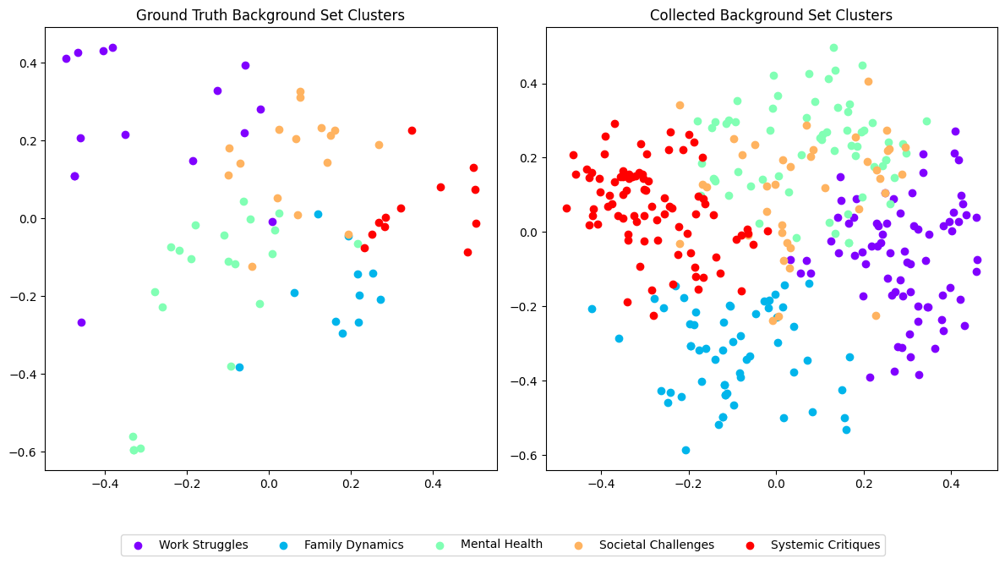
Information Extraction Phase for Collected Data
Ground Truth and Collected Data Clusters of Background Information

Slide 14
Limitations & Future Work
Dataset limited to Reddit and English-speaking, US-centric context.
No downstream evaluation yet (e.g., SES classifier or sentiment model).
Future: active learning, broader platforms, sociological grounding.

Slide 15
Contribution
Created a 5x larger dataset of low-SES student narratives.
Introduced a semi-automatic, iterative pipeline combining ML + human validation.
Released code and data to support future SES-related research.

Slide 16
Broader Impacts & Applications
Enables development of SES-aware NLP systems
Potential for applications in:
Education policy
Mental health support
Targeted interventions for underrepresented students

Slide 17


Thank you!
Thank you for your attention!
I'm happy to connect and discuss further.
nabdelgaber@smu.edu
https://www.linkedin.com/in/nahedmahmoud/

